Slide 1

FINAL-YEAR B.TECH PROJECT • PHASE I
WRAPTURE
AI-POWERED ECO – PACKAGING FOR GREENER E - COMMERCE
Department of Artificial Intelligence and Machine Learning • School of Engineering • VISTAS, Chennai
TEAM
PROJECT GUIDE
Chathurvitha S K • 23619232
Reyshmashri J • 23619226
Thasleem Safeeq M • 23619237
Dr. K. Ulaga Priya, M.E., Ph.D.
Associate Professor & Head, Dept. of AI&ML
Notes:
Good morning everyone. Our project is WRAPTURE, an AI-powered sustainable packaging recommendation system, developed in the Department of Artificial Intelligence and Machine Learning at VISTAS under the guidance of Dr. K. Ulaga Priya. In the next few minutes I will show how a user uploads a product photo and receives packaging options, and explain the six modules that make this possible.

Slide 2
Introduction and Problem Statement
THE PROBLEM
HOW WRAPTURE CONNECTS THE DECISION
E-commerce shipping needs a package that matches the product's size, with protection and a suitable material.
Choosing by eye can leave too little clearance, oversized boxes, avoidable void space or weak protection.
Comparing one product against a large catalogue in every orientation is slow and inconsistent by hand.
Material identification and recycling guidance usually sit in separate tools.
Product
1
Detected category and its dimensions
Packaging selection
2
Fit checked against 2,209 catalogue packages
Sustainable material choice
3
Problem statement Help users select suitable, more sustainable packaging by combining product detection, dataset-based dimensions, rule-based fit checking and material classification in one application.
Material class, catalogue CO₂e, recycling support
AI and data-driven recommendations make this choice faster, consistent and easier to justify.
Notes:
Motivation: every online order needs a package. If the box is too small the product is at risk; if it is too large we waste material and space. Today this is mostly done by eye or by a manual lookup in a big catalogue, and material and recycling information live in other tools. WRAPTURE brings these steps together: it detects the product, looks up its dimensions, checks and ranks packages in the catalogue, and separately classifies packaging material with recycling support. The goal is decision support for choosing suitable and more sustainable packaging.

Slide 3
Objectives and Overall User Workflow
1
Detect
2
Retrieve
3
Rank
4
Classify
5
Present
Detect product category with YOLO11
Get representative dimensions from the ABO-derived dataset
Check and rank package fit with deterministic rules
Classify material photos into seven classes with MobileNetV2
Show catalogue, recycling and visualization features
WORKFLOW A — PRODUCT PACKAGING RECOMMENDATION
Product image upload
Product category detection
Product dimension lookup
Packaging catalogue search
Fit checking and ranking
Packaging recommendation output
WORKFLOW B — MATERIAL CLASSIFICATION (SEPARATE)
Material image
Image processing
MobileNetV2 classification
Predicted material category
Recycling / sustainability guidance
Two independent paths in one app: Workflow A starts from a product photo and ends with ranked package options; Workflow B starts from a packaging-material photo and ends with a material class. Material classification is not a required step inside Workflow A.
Notes:
Our five objectives are on top. Below are the two workflows. Workflow A is the packaging recommendation: the user uploads a product image, YOLO11 detects the category, the system looks up dimensions from the dataset, searches the packaging catalogue, checks fit and ranks, and shows the recommendations. Workflow B is separate: the user photographs a packaging material, the image is preprocessed, MobileNetV2 classifies it, and the app shows the predicted material class with recycling guidance. I want to stress that these are two paths in the same application - material classification is not a mandatory step of the packaging recommendation.

Slide 4
System Architecture and Six Modules
Product path (top)
React UI
Flask API
① YOLO11s
② ABO lookup
③ Fit engine
Ranked options
Upload / choose item
REST routes + JSON
Category detection
Representative L×W×H
6 rotations + 10% clearance
Top 5 in scan pipeline
ABO-derived data
Packrift catalogue
42,651 records
2,209 packages
Material path (bottom)
Material photo
④ MobileNetV2
Material result
⑤ Sustainability
⑥ UI & visualization
Camera / upload
7 classes • 224×224 RGB
Class + confidence
Catalogue CO₂e • locator • EcoPoints
three.js • TrashGPT • dashboard
1 Product detection
2 Dimension lookup
3 Packaging recommendation
4 Material classification
5 Sustainability & recycling
6 Visualization & UI
React UI → Flask API → YOLO11s → ABO lookup → fit engine + catalogue → ranked options; the material photo goes through MobileNetV2 on its own path; results reach the user through the UI, 3D preview and assistant.
Notes:
This is the architecture. The React interface sends images and inputs to a Flask REST API. In the product path, YOLO11s detects the category, the ABO-derived dataset gives a representative size, and the fit engine checks the Packrift catalogue in six rotations with 10 percent clearance and returns ranked options. In the material path, a photo goes through MobileNetV2, which returns a class and confidence. The sustainability module adds catalogue CO2e, the recycling locator and EcoPoints, and module six presents everything - the interface, the three.js 3D preview and the TrashGPT assistant. The same Flask API is also used by the Android build of the app over the local network.

Slide 5
Technologies and Datasets
Layer | Technology | Role in WRAPTURE
Interface | React UI (web) + Android build | Upload, results, 3D preview, chat
Backend | Python Flask REST API | Vision, products, packaging, sustainability routes
Detection | Ultralytics YOLO11s | Product category, confidence, bounding box
Material model | TensorFlow / Keras MobileNetV2 | Seven-class material classification
Visualization | three.js | Visual 3D packaging preview
42,651
ABO-derived product records
Valid dimensions → supplies product types and L×W×H for lookup
2,209
Packrift packaging catalogue
1,303 boxes • 684 mailers • 222 poly bags → SKU, size, material, price, protection, CO₂e
2,616 + 645
Android build: the APK calls the same Flask API; its URL is set to the computer's LAN IP on the same Wi-Fi.
Material images (7 classes)
Datasets drive three jobs: dimensions for fit checking, packages to choose from, and images to train the material classifier.
Training images + unseen test images → trains and tests MobileNetV2
Notes:
Technology stack: React interface, Python Flask backend, Ultralytics YOLO11s for detection, a TensorFlow/Keras MobileNetV2 model for materials and three.js for the visual 3D preview. There are three datasets. The ABO-derived subset has 42,651 products with valid dimensions - it gives us sizes. The Packrift-derived catalogue has 2,209 packages: 1,303 boxes, 684 mailers and 222 poly bags - these are the candidates. The material dataset has 2,616 training and 645 unseen test images across seven classes.

Slide 6
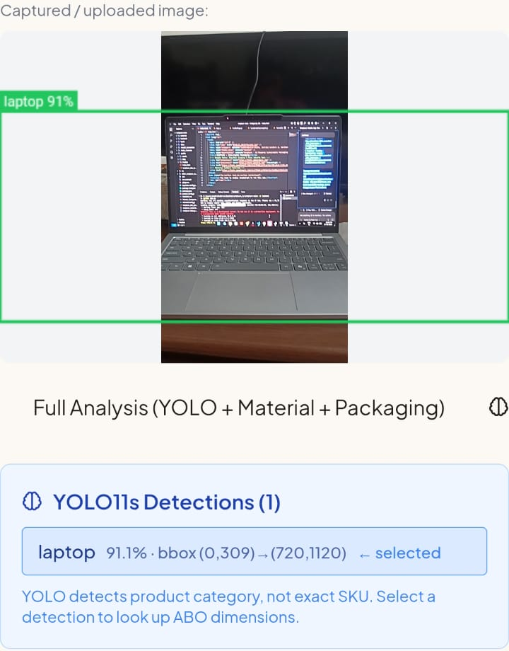
Module 1: Product Detection Using YOLO11
Category label + confidence
Purpose Identify the product category from a user's photo.
Input Product image (camera or upload), decoded as RGB.
Processing YOLO11s detects objects; detections above 0.35 are returned with class, confidence and box. The user selects the detection that matches the product.
Output Selected category (e.g. “laptop”) passed to dimension lookup.
“laptop 91%” on the image
Bounding box
Green box (0,309)→(720,1120)
Input image
Photo captured / uploaded
Detection result
YOLO11s Detections (1): laptop 91.1%, selected
Detects a product category, not an exact SKU. The 91.1% is one photo's confidence, not model accuracy.
Image Upload
YOLO11
Product Category
Dimension Lookup
Notes:
Module one is product detection. The user uploads or captures a photo; Flask decodes it and YOLO11s returns detections above a 0.35 confidence threshold, each with a class, confidence and bounding box. In this real screenshot the model detected a laptop at 91.1 percent, and you can see the green bounding box and label. The user selects the detection that matches the product - we do not assume the highest confidence is always correct. Important: YOLO detects a product category such as laptop, not an exact SKU, and 91.1 percent is the confidence for this one photo, not the model's overall accuracy.

Slide 7
Module 2: Product Dimension Lookup
Detected category
Dataset search
Matching product record
Retrieved dimensions
Recommendation engine
INPUT
PROCESSING
OUTPUT
Category chosen from YOLO11 (e.g. “laptop”)
Mapped to an ABO product type using COCO_TO_ABO
Search ABO-derived records for that type
Keep records with valid L, W, H
Sort by volume; take the median-volume record
Pass L × W × H (and weight if present) to the fit engine
Matching product type / record
Length, width, height
Weight only where the dataset has it
Representative size for the category
42,651
Retrieved, not measured. Dimensions come from stored dataset records for the category; the photo is not used to measure size or weight. The category must map to a supported ABO type with valid dimensions.
ABO-derived records with valid dimensions (~524 product types)
Notes:
Module two turns a category into dimensions. The detected category - for example laptop - is mapped to an ABO product type through the COCO-to-ABO mapping. We take the valid-dimension records of that type, sort them by volume and use the median-volume record as the representative product. Its length, width and height - and weight where available - go to the recommendation engine. Please note: the dimensions are retrieved from the dataset, they are not measured from the photo. The subset has 42,651 valid-dimension records and roughly 524 product types.

Slide 8
Module 3: Packaging Recommendation Engine
1
Receive product dimensions
WORKED EXAMPLE (illustrative calculation)
Product (simulator smartphone): 7 × 15 × 1 cm = 2.76 × 5.91 × 0.39 in
+10% each axis → 3.03 × 6.50 × 0.43 in
BINB212 (12 × 2 × 4.5 in): 6.50→12 ✓ 3.03→4.5 ✓ 0.43→2 ✓ → fits in this orientation
The engine tries all 6 permutations of the product's axes; one fit is enough.
2
Search the packaging catalogue
3
Apply 10% clearance on each axis
Test all six axis-aligned orientations
Package | Size (in) | Fit | Unused vol. | Material | Price/unit | Rank
BINB212 | 12×2×4.5 | ✓ | 94.1% | Corrugated | $0.87 | 1
BINB412 | 12×4×4.5 | ✓ | 97.0% | Corrugated | $0.96 | 2
BINB418 | 4×18×4.5 | ✓ | 98.0% | Corrugated | $1.21 | 3
BINB612 | 6×12×4.5 | ✓ | 98.0% | Corrugated | $1.43 | 4
4
5
Keep packages that satisfy fit
6
Rank by unused volume, protection, material, price
Illustrative only: catalogue sizes, prices and material are from the EcoShop screen; fit, unused volume (1 − product volume ÷ package volume) and rank (by unused volume) were calculated for this example, not captured system output.
7
Return ranked options to the UI
Ranking lets users compare suitable options side by side: tighter fit, protection, material and price. Rule-based checking only — no structural simulation.
Notes:
Module three is the recommendation engine, and it is rule-based. It takes the retrieved dimensions, adds 10 percent clearance on every axis, and checks each catalogue package in all six axis-aligned orientations - the six ways to permute length, width and height. Packages where at least one orientation fits are candidates, and they are ranked using unused volume, protection, material and price. The worked example on the right is illustrative: I used the simulator smartphone 7 by 15 by 1 centimetres and four real catalogue records from the EcoShop screen. With clearance the phone becomes about 3.03 by 6.50 by 0.43 inches, which fits the 12 by 2 by 4.5 inch box. The fit, unused volume and ranks in that table were calculated for the example, not output by the app. The engine does not use physical testing or structural simulation.

Slide 9
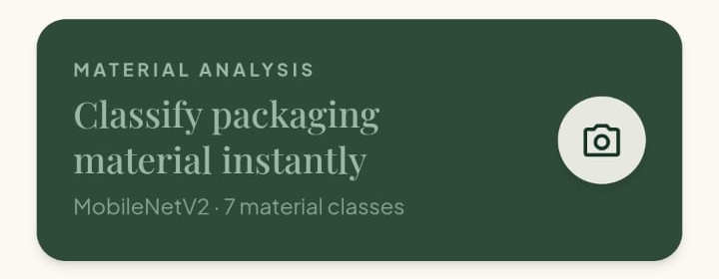
Module 4: Material Classification Using MobileNetV2
Material image
Preprocessing
MobileNetV2
Class prediction
Displayed result
SEVEN MATERIAL CLASSES
86.98%
Cardboard
Compost
Boxes, cartons
Food / organic
Test accuracy on 645 unseen images
Real app screen: material analysis entry
Glass
Metal
Input Photo of a packaging material (camera / upload).
Processing RGB, 224 × 224 preprocessing, then MobileNetV2 scores seven classes.
Output Top class with confidence; recycling help via the app's recycling features.
Bottles, jars
Cans, foil
2,616
645
training images
unseen test images
Paper
Plastic
Sheets, wrappers
Bottles, bags
Test accuracy = share of the 645 unseen images the model classified into the correct one of seven classes.
Trash
Mixed non-recyclable
Notes:
Module four is a separate workflow. The user photographs a packaging material in the app - this is the Material Analysis card on the home screen, which says MobileNetV2, seven material classes. The image is converted to RGB, resized to 224 by 224 and passed to MobileNetV2, which returns scores for seven classes: cardboard, compost, glass, metal, paper, plastic and trash. The app shows the top class with its confidence. The model was trained on 2,616 images and tested on 645 unseen images, giving 86.98 percent test accuracy - that simply means about 87 out of every 100 unseen images were assigned the correct class. We have not reported per-class precision or recall, so I will not quote any.

Slide 10
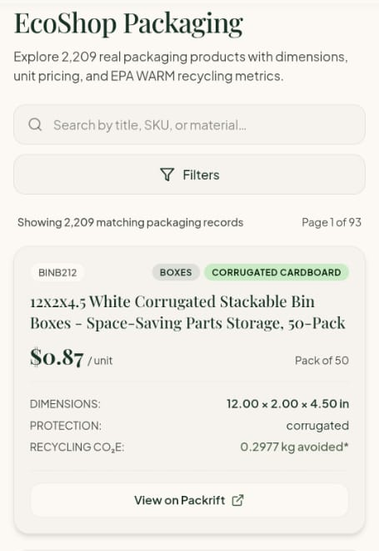
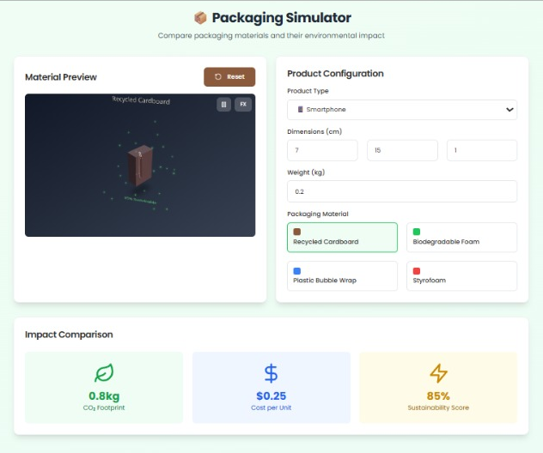
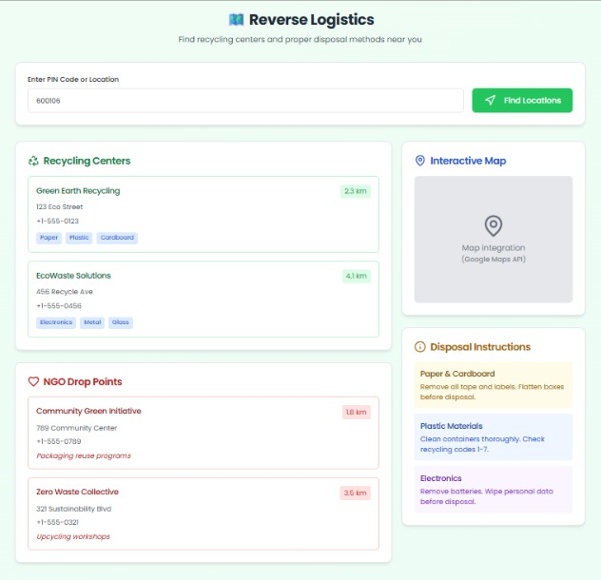
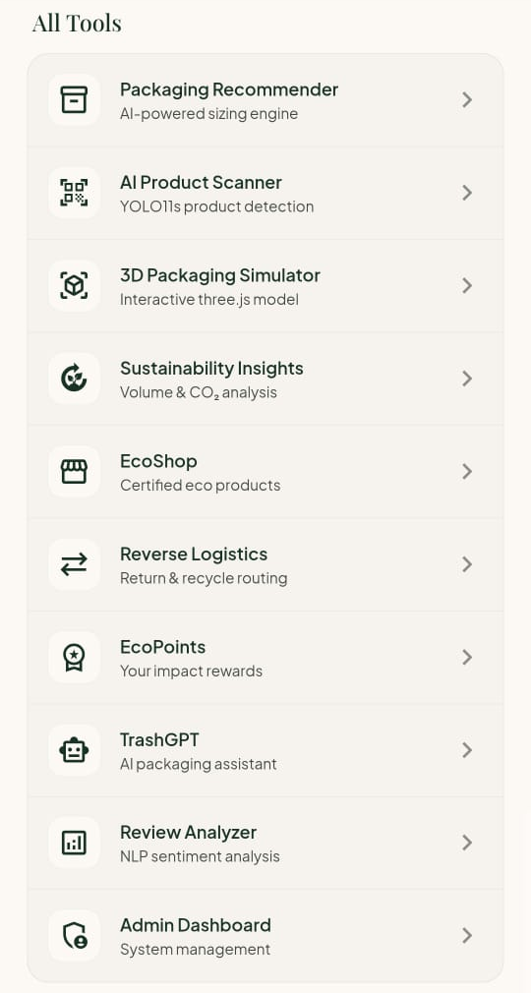
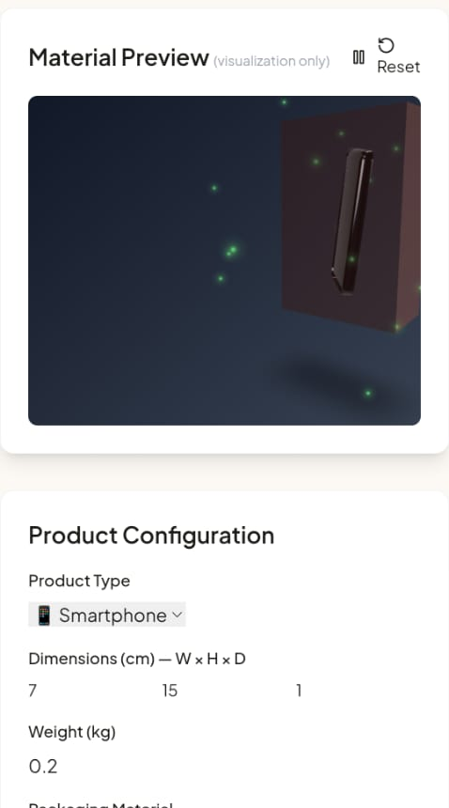
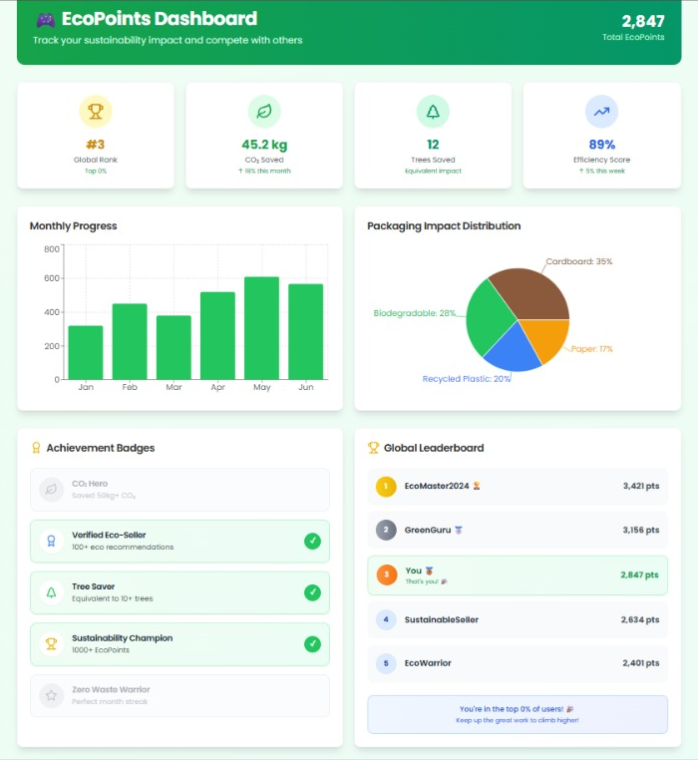
Modules 5 and 6: Sustainability and Interface
5
Sustainability and Recycling
6
Visualization and User Interface
EcoShop: catalogue records with size, price, protection, CO₂e
Recycling locator (Reverse Logistics) and disposal tips
EcoPoints rewards for sustainable choices
Scan: upload a product photo, see detections
Packages: ranked options; EcoShop browsing
3D simulator, TrashGPT assistant, Admin dashboard
TrashGPT packaging assistant
Recycling locator (sample data)
EcoPoints (sample data)
The 3D view is a visual preview, not structural simulation.
*CO₂e is catalogue-derived where available; not a full life-cycle assessment. Recycling locator and EcoPoints screens show sample data.
EcoShop: 2,209 records, EPA WARM CO₂e*
All Tools menu
3D simulator (catalogue data)
Notes:
Modules five and six are what the user actually touches. On the left, sustainability: EcoShop lets users browse all 2,209 packaging records with size, price, protection and a recycling CO2e figure from EPA WARM for qualifying corrugated packaging - this is catalogue-derived and not a full life-cycle assessment. The Reverse Logistics screen is the recycling locator, and EcoPoints rewards sustainable choices; those two screenshots show sample data. On the right, the interface: the All Tools menu lists the scanner, packaging recommender, 3D simulator, EcoShop, TrashGPT, EcoPoints and the admin dashboard. The 3D simulator draws the product inside a package from real catalogue data - it is a visualization, not CAD-grade simulation - and TrashGPT answers packaging and recycling questions.

Slide 11
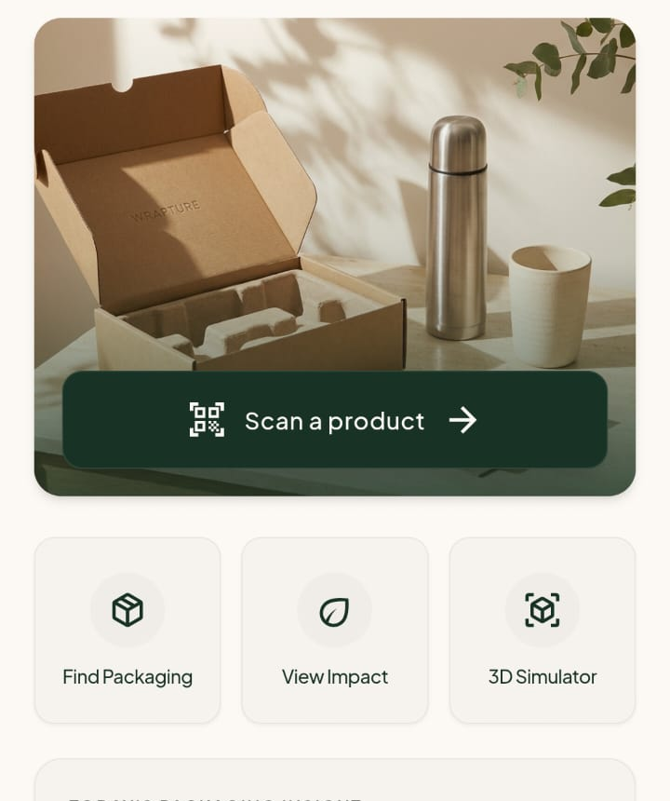
End-to-End User Demonstration: Laptop Example
1
Upload product image
2
Detect product category
3
Retrieve dimensions
4
Recommend packaging
5
Display final results
Input: Product Image
Processing: AI-Based Product Detection
Processing: Dataset-Based Lookup
Processing: Fit Checking and Ranking
Output: Suitable Packaging Recommendations
PLACEHOLDER
Insert screenshot of the retrieved laptop dimensions
Tap Scan a product; choose or capture the photo.
YOLO11s returns class, confidence and box.
Category maps to an ABO type; median-volume record gives L×W×H.
10% clearance, six orientations, then ranking over the catalogue.
Chosen package and product shown in the 3D preview with catalogue metrics.
Output: Image sent to the Flask API.
Output: laptop 91.1%, selected.
Output: Dimensions from the dataset, not the photo.
Output: Catalogue records with size, price, protection, CO₂e.
Output: Package size, material and preview.
Notes:
Speaking script for the demo. Step 1: on the home screen I tap Scan a product and choose a photo - here a laptop. The image goes to the Flask API. Step 2: YOLO11s returns its detection - laptop, 91.1 percent, with a bounding box - and I select it. Step 3: the category is mapped to an ABO product type and the median-volume record supplies length, width and height; these come from the dataset, not from the photo. [The screenshot in this box is a placeholder - insert the laptop dimensions screen before presenting.] Step 4: the fit engine adds 10 percent clearance, tries six orientations against the 2,209 catalogue packages and ranks the ones that fit; here you see the kind of catalogue records it works with - size, price, protection and recycling CO2e. Step 5: the result is shown visually in the 3D simulator, with the product inside the chosen package using catalogue data. Remember to say that the simulator is a visual preview.

Slide 12
Testing, Evaluation and Results
Evaluation item | Verified value
Product records with valid dimensions | 42,651
Packaging catalogue records | 2,209
Material classification training images | 2,616
Material classification unseen test images | 645
Material classification test accuracy | 86.98%
Packaging catalogue fit coverage | 94.25%
Catalogue fit coverage
Fit coverage
Classifier accuracy
Functional checks
40,200 ÷ 42,651 = 94.25%: records with at least one fitting catalogue package. It is coverage, not recommendation accuracy.
86.98% of 645 unseen images were classified correctly across seven classes.
7 manual app checks on Android over local Wi-Fi: all 7 passed. YOLO11: one documented laptop detection (91.1% confidence), not an aggregate metric.
Notes:
These are the verified results. The product dataset has 42,651 valid-dimension records, the catalogue has 2,209 packages, and the material classifier was trained on 2,616 images and tested on 645 unseen images with 86.98 percent accuracy. Packaging catalogue fit coverage is 94.25 percent, which is 40,200 divided by 42,651 - it tells us that for most product records the catalogue has at least one package that fits, and it is not the accuracy of the recommendations. For functional testing we ran seven manual checks on an Android phone over local Wi-Fi and all seven passed. For YOLO11 we have one documented example - the laptop at 91.1 percent - so I present that as an example, not as a model-wide metric.

Slide 13
Project Achievements and Technical Standards
AI-based product-category detection
Dataset-based dimension retrieval
Standards and engineering guidance referenced
✓
✓
ISO/IEC/IEEE 29148:2018
Requirements engineering
Rule-based fit checking and ranking
Material classification, seven classes
IEEE 1016-2009
✓
✓
Software design documentation
ISO/IEC 25010:2023
Software product quality model
Sustainability and recycling features
Interactive packaging visualization
✓
✓
ISO/IEC/IEEE 29119
Software testing
ISO/IEC 23894:2023
Unified web interface (Android build too)
Quantitative evaluation of classifier and fit coverage
AI risk management guidance
✓
✓
Referenced as guidance only; no formal certification or compliance is claimed.
Notes:
Left: what we completed - detection, dimension retrieval, rule-based fit and ranking, a seven-class material classifier, sustainability and recycling features, an interactive 3D preview and one interface, plus quantitative evaluation of the classifier and the catalogue fit coverage. Right: the engineering standards we used as guidance - 29148 for requirements, IEEE 1016 for design documentation, ISO 25010 for quality, 29119 for testing and ISO 23894 for AI risk. We refer to them as guidance; we are not claiming certification. (Please re-check the edition years against your report before the viva.)

Slide 14
Conclusion and Future Enhancements
CONCLUSION
FUTURE ENHANCEMENTS
YOLO11 product-category detection
Dataset-based dimension retrieval
Rule-based fit checking and ranking
MobileNetV2 material classification
Sustainability and recycling support
Interactive interface and 3D visualization
Datasets
Identification
Expand product and packaging data
Improve product ID and dimension retrieval
Materials
Recommendation
Extend material classification
Enhance ranking and visualization
Together these modules give a practical, data-driven workflow: from a product photo to ranked packaging options, with material and recycling support alongside.
Environment
Usability
Add broader environmental impact data
Improve usability, widen evaluation
Notes:
To conclude: WRAPTURE connects AI detection, dataset-based dimensions, rule-based fit checking and ranking, material classification and sustainability features in one application. It gives users a practical way to go from a product photo to ranked packaging options. Going forward we plan to expand the datasets, improve product identification and dimension retrieval, extend material classification, enhance recommendations and visualization, bring in broader environmental impact information and keep improving usability and evaluation coverage.

Slide 15
THANK YOU
WRAPTURE: AI-POWERED ECO – PACKAGING FOR GREENER E - COMMERCE
VELS Institute of Science, Technology & Advanced Studies • Department of AI&ML
Notes:
Thank you. I am happy to answer questions, and I can run the application live: scan a product, show the detection, the packaging options and the 3D preview, or classify a material photo.

